Slide 1
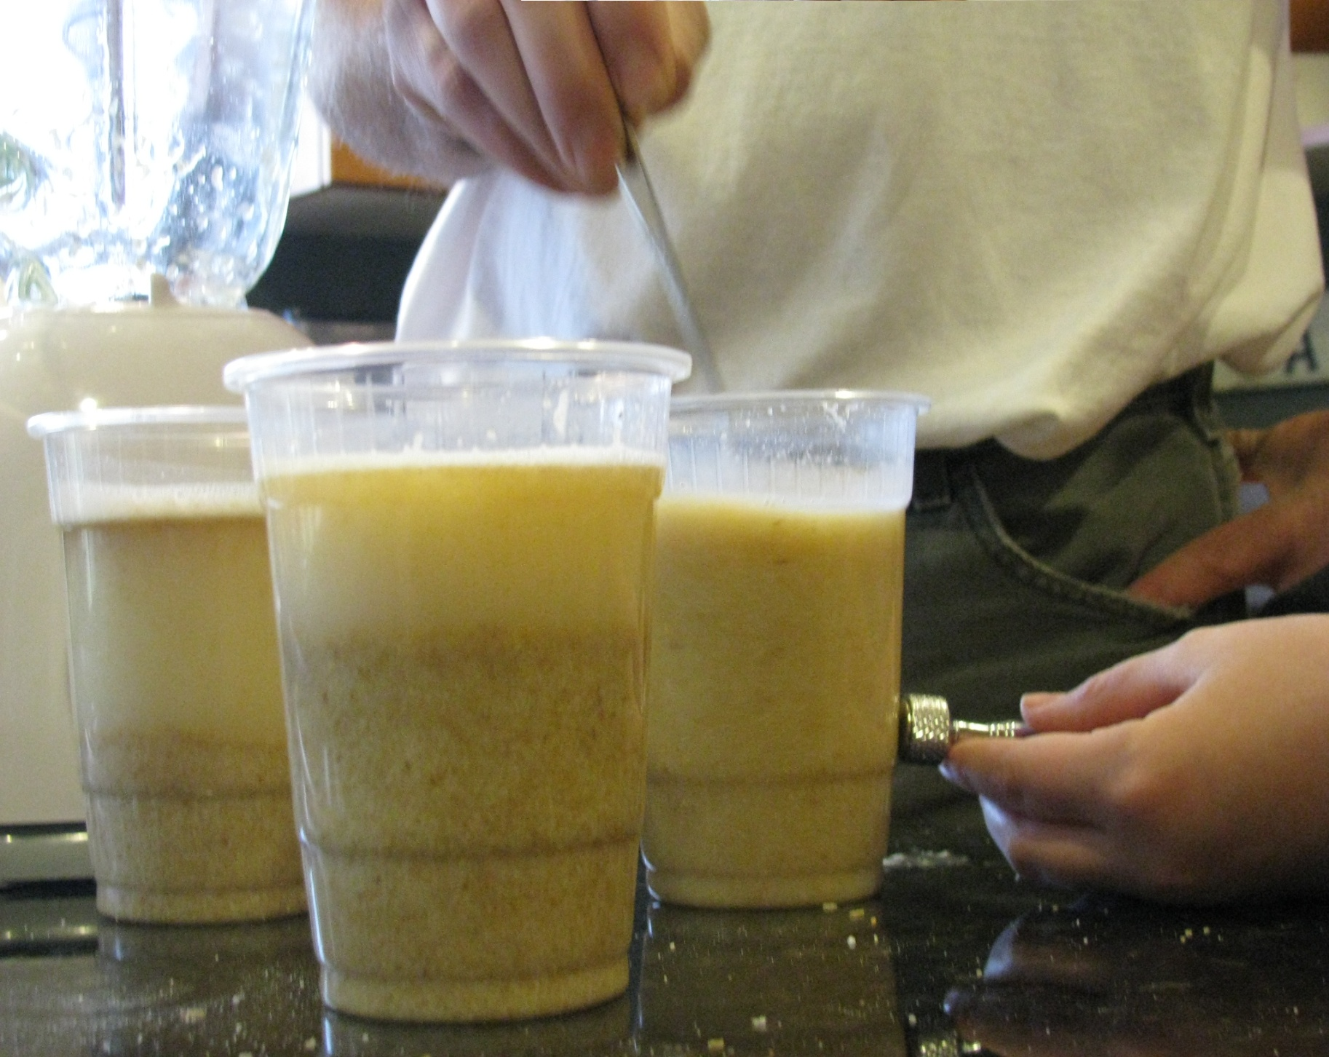
Mag-nificant Breakfast Cereal
By: Kim Hammer & Philip Paulson
SCED 322 Fall quarter 2010
Results & Discussion
We were able to conclude that cereal nutritional labels were fairly accurate. Of our three samples, one sample was almost double the expected amount of iron per serving, one was just below the expected value per serving, and one was within a half mg per serving of the expected value from the nutritional information on the printed packaging. We were not able to determine that any given cereal contained more or less iron per volume of cereal because for each sample of 454 grams of cereal, 100 mg of iron were extracted. This lack of differentiation between the amount of iron extracted could have been caused by the inadequate accuracy of the instruments used to test the weight of iron removed, the solubility of ferrous compounds in water, or ionization in the dissolution process. As a result of the uniform mass of extracted iron, the major determinant of mass of iron per serving size was the serving size itself, because it meant we were dividing the same amount of iron across fewer serving for a given sample. This was a variable we were not able to control, as the serving size was dictated to us by the nutritional information on the package and it seems to have been reflected in our data, as serving size is positively correlated to increased iron content per serving. This causes Raisin Bran, with the largest serving among the cereals sampled, to be a significant outlier in our relatively small data set. We were able to control for the mass of cereal being tested and the amount of water being added, but we were not able to control the physical properties of the individual cereals, though with a given mass, solubility in water is the major confounding variable.
If we repeated this experiment, we would hope to gather more accurate readings of the mass of iron extracted, so that the serving size would not play a pivotal role in our results. We could either do this by accessing a more accurate scale or through a titration of the iron to iron oxide. This last option holds two major advantages, it is the most accurate measure of the amount of iron present and would also mitigate.
Introduction
Many brand name foods contain additives. When a food manufacturer adds a nutritional supplement as an additive to a processed food, they are required to report that information on the food label. The %Daily Values (%DV's) are based on the daily value recommendations for key nutrients for a 2,000 calorie daily diet. The %DV helps you determine if a serving of food is high or low in a nutrient (USFDA, 2004). The higher the percentage, the more of that nutrient is present in the food; the lower the percentage, the less of that nutrient is present in the food. In this experiment, I will use a magnet to pull supplemental iron additives out of selected breakfast cereals. Then I will weigh the iron powder extracted from the selected cereals to see how much iron they contain.
Question
How much iron is in my cereal?
Which brand of cereal will have the most iron in it?
Objective
The objective of this experiment is to devise a method of extracting supplemental iron from food to compare the iron content of several brands of breakfast cereal.
Hypothesis
Mini Wheats will show the most iron extracted then Raisin Bran or Honey Bunches of Oats because it has a higher listed iron percentage per serving (90%) than the other two (60%).
Qualitative Results
Iron was observed as magnet reactive black flakes after evaporation of water.
Discoloration of flakes suggests impure iron extract or oxidation.
Warm water to rinse iron pellet seemed to work better that cold water though distilled water was still used.
Iron was hardest to remove from the Bran flakes as the cereal seemed to be thicker and more dense. More water was needed.
Raisin Bran took twice as long to blend due to the amount of raisins in the cereal.
Method and Materials
Assortment of breakfast cereals
Raisin Bran *Mini Wheat's *Honey bunches s of Oats.
Blender
Clear Plastic 16 oz. cups
Plastic spoons
Heavy duty magnet
Metric measuring cup
Scientific balance
Choose several kinds of breakfast cereal to test. You will need 454 g of each cereal for the experiment. Put 200 g of cereal in the blender at a time and add 500 mL of distilled water. Blend the water and cereal on high until you have a smooth slurry and there are no visible lumps or chunks of cereal left. Carefully pour the slurry into a clear plastic cup. Label the plastic cup with the name of the cereal you are testing. Rinse the blender with a small amount of water (20 mL) and pour into the cup. Hold the magnet against the outside of the cup and slowly stir the slurry with a plastic spoon. While you are stirring the cereal, you may notice iron particles collecting near the magnet on the inside of the cup where you are holding the magnet. Continue to stir for 1 minute. Carefully decant (pour off) the cereal slurry. Be very careful not to move the magnet from the side of the cup, or to disturb the pellet of iron collected on the magnet. Add 40mL of water to the cup and stir for an additional minute. This will clean the pellet of iron of any cereal debris. Carefully decant (pour off) the water. Be very careful not to move the magnet or to disturb the pellet of iron. Continue procedure until all cereal is used. Leave the plastic cup to air-dry for 1–2 hours. Choose a location that is not windy or breezy so that your cups will not tip over. If you like, transfer your iron powder to a small plastic sandwich bag. Label each baggie with the type of cereal the iron powder came from using a permanent marker. Now you are ready to weigh your iron powder. Next you will need to divide the weight of the iron in milligrams by the weight of the cereal in grams so that your measurement of iron will be in mg of iron per g of cereal (mg/g). Now you can graph the Percent Daily Value of Iron (%) versus the Amount of Iron per Gram of Cereal (mg/g) and the experimental percent of iron per serving compared to the stated statistic.
Conclusion
Our hypothesis that the Mini Wheats cereal would have more iron per serving than either of the other cereals was not demonstrated in our data. Raisin Bran had the most iron per serving due to size of serving. Further investigation and different forms of measurement is needed to gain more accurate results for this experiment.
Quantitative Results
Based on 13mg average daily value iron
Comparative Data Table
 |  | Mini Wheats | Raisin Bran | Hony Bunches of Oats
1 | Sample Size(g) | 454 | 454 | 454
2 | Serving Size (g) | 55 | 59 | 30
3 | Servings per Sample | 8.25 | 7.69 | 15.13
4 | Theoretical % daily Fe per serving | 90% | 60% | 60%
5 | Theoretical Daily Need Fe(mg) | 11.7 | 7.8 | 7.8
6 | Actual weight of Fe (mg) | 100 | 100 | 100
7 | Observed weight Fe per serving(mg) | 12.12 | 13.00 | 6.60
Literature cited
How to Understand and Use the Nutrition Facts Label," United States Food and Drug Administration (USFDA), Center for Food Safety and Applied Nutrition. [accessed October 21, 2007] http://www.cfsan.fda.gov/~dms/foodlab.html Brooks, D.W., 2007. "Expt 007 - Iron in Cereal - Separation," Teaching and Research Website, Center for Curriculum and Instruction, University of Nebraska-Lincoln. [accessed September 6, 2007] http://dwb4.unl.edu/chemistry/beckerdemos/BD007.html
APS, 2007. "Physics Central: Physics at the Breakfast Table," American Physical Society (APS). [accessed September 6, 2007] http://www.physicscentral.com/athome/iron.html
Acknowledgments
This project was adapted from a student project submitted to the Marin County Science Fair in California.
Sara Agee, Ph.D., Science Buddies
informationhttp://www.sciencebuddies.org/science-fair-projects/project_ideas/FoodSci_p003.shtml

